Slide 1
Characterizing and Detecting Performance Bugs for Smartphone Applications
论文讲析

Slide 2
文章结构
RQ2 Bug manifestation
引言
提出文章线索
背景介绍
经验学习（EMPIRICAL STUDY）
分析RQ1-4
性能问题检测（DETECTING PERFORMANCE BUGS）
实现RQ5
相关工作介绍
总结
RQ1 Bug types and impacts
RQ3 Debugging and bug-fixing effort
RQ4 Common bug patterns
RQ5 Performance Bug Checking

Slide 3
引言——文章线索
针对性能错误（performance Bug）提出了5个问题
RQ1
What are common types of performance bugs in Android applications?
What impacts do they have on user experience?
RQ2
How do performance bugs manifest themselves?
Does their manifestation need special inputs?
RQ3
Are performance bugs more difficult to debug and fix than non-performance bugs?
What information or tools can help with this?
RQ4：
Are there common causes of performance bugs?
Can we distill common bug patterns to facilitate performance analysis and bug detection?
RQ5
Can we leverage our empirical findings, to help developers identify performance optimization opportunities in real-world Android applications?

Slide 4
RQ1:Bug types and impacts
What are common types of performance bugs in Android applications?
GUI lagging
Energy Leak
Memory bloat
What impacts do they have on user experience?
GUI lagging may cause ANR(Application Not Responding).
Memory bloat may cause OOR(Out of memory).
Energy Leak may cause great inconvenience to users.

Slide 5
RQ2:Bug Manifestation
How do performance bugs manifest themselves?
Automated performance oracle needed.
Performance bugs can be platform-dependent.
Does their manifestation need special inputs?
Small-scale inputs suffice to manifest performance bugs in smart phone.
More than one third (25 out of 70) of performance bugsrequire special user interactions to manifest.

Slide 6
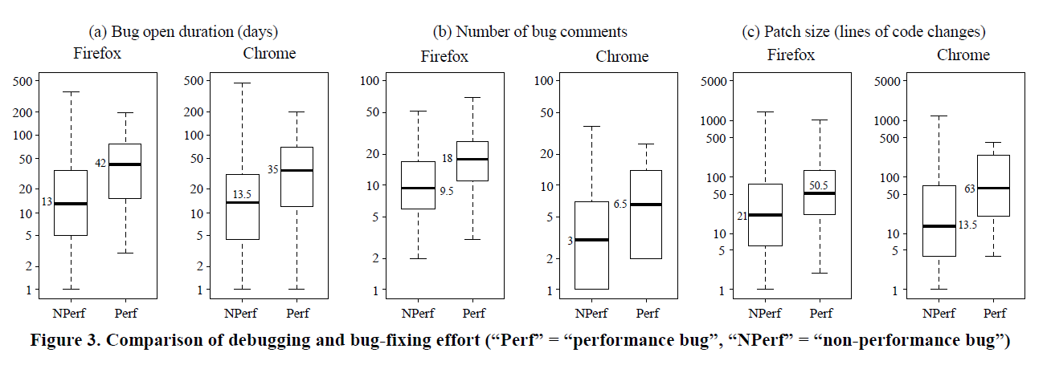
RQ3: Debugging and bug-fixing effort
Are performance bugs more difficult to debug and fix than non-performance bugs?

Slide 7
RQ3: Debugging and bug-fixing effort
What information or tools can help with this?
Profiling tools
which runtime information can actually help performance debugging is still an open question.
General tools is needed.
Performance measurement tools
algorithmic changes
design pattern reimplementation
data structure or caching scheme redesign

Slide 8
RQ4: Common bug patterns
Are there common causes of performance bugs?
Lengthy operations in main threads
Wasted computation for invisible GUI
Frequently invoked heavy-weight callbacks

Slide 9
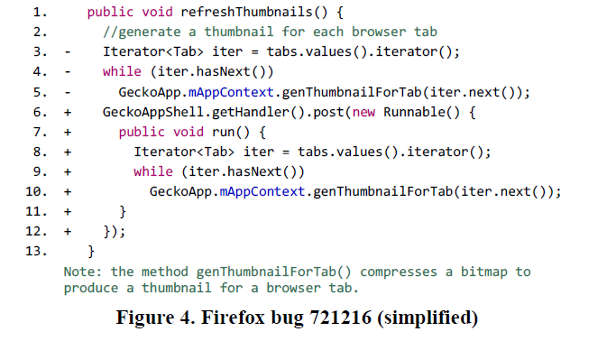
Lengthy operations in main threads

Slide 10
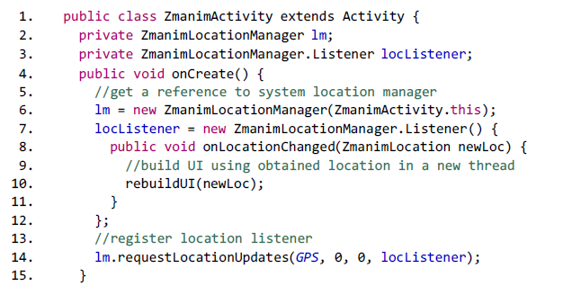
Wasted computation for invisible GUI

Slide 11
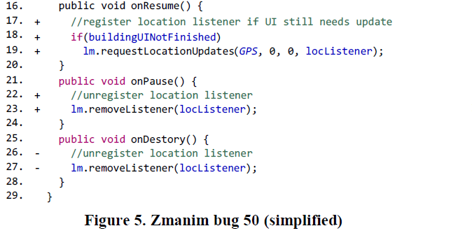
Wasted computation for invisible GUI

Slide 12
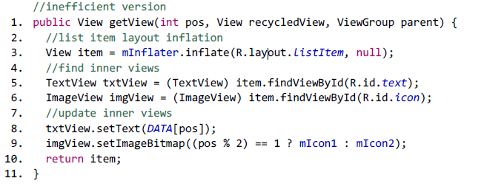
Frequently invoked heavy-weight callbacks

Slide 13
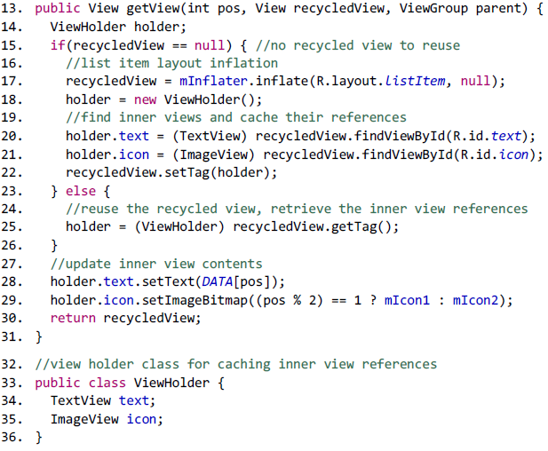
Frequently invoked heavy-weight callbacks

Slide 14
Detecting Performance Bugs
Performance Bug Checking Algorithms
Detecting lengthy operations in main threads
Detecting violation of the view holder pattern
Study Results and Developer’s Feedback

